Slide 1

Basic Details of the Team and Problem Statement
Problem Statement Title:
Suggest an AI-based solution to enable ease of grievance lodging and tracking for citizens across multiple departments
Theme Name: Smart Automation
Team Name: Assistify
Team Leader Name: Samrridh Khanna
School Code: 60345
School Name: Mayoor School Noida
Notes:
Grievance Resolution Squad
Voice of the Employee
Speak Up Squad
Grievancebusters
Grievance Whisperers
Grievance Ninjas

Slide 2
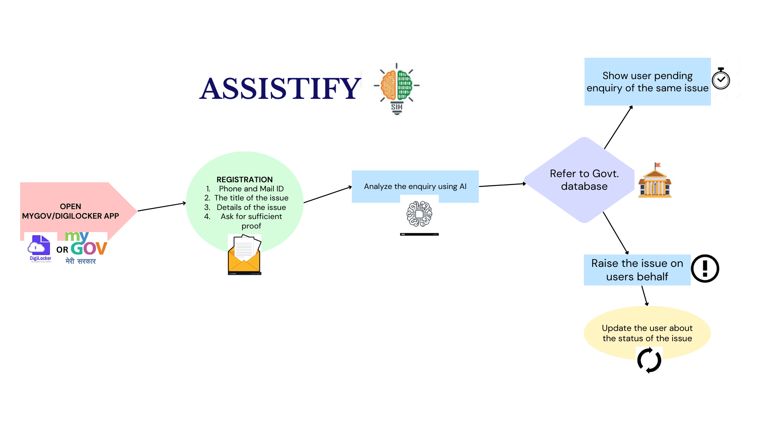
Idea/Approach Details
Describe your idea/Solution/Prototype here:
Integrate Grivence lodging chatbot with Mygov/ Digilocker App
Raise query using Augmented Reality or text
Processing of input using large language model(LLM) and natural language processing(NLP)
The concerned department gets notified and reviews the problem
Unique Compant number is generated, and gets regular update on the grievance
Department resolves and updates the status
Follow up conversation if needed and feedback
https://www.canva.com/design/DAFyjB6SSA0/Bf2JV3mw_yAPTDJEwXGZJw/edit or zoom in to see
Describe your Technology stack here:
BACKEND: PYTHON
FRONTEND: HTML,CSS AND JS
DATABASE: POSTGRE SQL
SMS : TWILIO API
EMAIL: GMAIL
LLM : LLAMA 2 (META)
INTEGRATION : MYGOV & DIGILOCKER

Slide 3
Idea/Approach Details
Describe your Use Cases here
Describe your Dependencies / Show stopper here
Local Government Complaints - potholes, garbage collection, street lighting, and water supply etc
Public Health Concerns - Sanitation issues
Transportation and Traffic Issues-Rule violations, accidents
Consumer Complaints
Environmental Concerns
Safety and Security -Harassment, Theft, Vandalism
Public Infrastructure-Bridges,Parks,Public Building
Emergencies and Disaster Management
Multilingual Support - Supports Local Languages
Augmented Reality - Complaint by showing problem
Crowdsourcing Solutions - Citizen can also propose solution
Accessibility Features - For Specially Abled people
Citizen Feedback Loop -
Offline Support - SMS
Third-Party Integration - NGO’s, community groups
Citizen Impact Score - Based on their contributions
Anonymous Reporting with Accountability

Slide 4
Team Member Details
Team Leader Name: Samrridh Khanna
Class (6th to 12th ): 11 Stream* (Arts/Science/Commerce etc): Science Age (in number): 16 Gender (M/F): M
Team Member 1 Name: Divyam Jindal
Class (6th to 12th ): 12 Stream* (Arts/Science/Commerce etc): Science Age (in number): 16 Gender (M/F): M
Team Member 2 Name: Agastya Vohra
Class (6th to 12th ): 11 Stream* (Arts/Science/Commerce etc): Science Age (in number): 16 Gender (M/F): M
Team Member 3 Name: Sia Anand
Class (6th to 12th ): 12 Stream* (Arts/Science/Commerce etc): Arts Age (in number): 17 Gender (M/F): F
Team Member 4 Name: Arjun Krishna
Class (6th to 12th ): 12 Stream* (Arts/Science/Commerce etc): Science Age (in number): 17 Gender (M/F): M
Team Member 5 Name: Anoushka Verma
Class (6th to 12th ): 11 Stream* (Arts/Science/Commerce etc): Science Age (in number): 16 Gender (M/F): F
Team Mentor 1 Name: Kawalpreet Kalra
Category (Academic/Industry/Parents): Academic Expertise (AI/ML/Blockchain etc): Science Domain Experience (in years): 13
Team Mentor 2 Name: Tanuj Vohra
Category (Academic/Industry/Parents): Parent Expertise (AI/ML/Blockchain etc): Corporate Law Practise Domain Experience (in years): 20

